Slide 1

Road Accident Prediction and Risk Classification in India
Fathimathul mina c h

Slide 2
Project Objective
To analyze road accident patterns in India (2016–2022) using state-wise data
Perform preprocessing and detailed EDA to understand trends, especially in Kerala
Build regression model to predict the exact number of accidents
Build classification model to predict high-risk vs low-risk accident years
Compare models, select the best, and tune hyperparameters
Provide actionable insights for road safety (focus on Kerala)

Slide 3
Problem Statement
India has one of the highest road accident rates globally (~1.5 lakh deaths/year – MoRTH)
Accidents are unevenly distributed — concentrated in large states like Tamil Nadu, Kerala, Madhya Pradesh
Current analysis is mostly retrospective; lack of predictive tools to forecast numbers or identify high-risk years early
Without prediction models, proactive safety planning (police deployment, campaigns) is difficult

Slide 4
Dataset Overview
Source: Merged & preprocessed from ~7 raw datasets downloaded from data.gov.in (Ministry of Road Transport & Highways / related transport data)
Rows: 175 state-year records
Time Period: 2016–2022 (recent, reliable reporting years)
Key Columns:
1. State_UT (categorical – 35 states/UTs)
2. Year (numeric)
3. Accidents_clean (main target for regression – cleaned accident count)
4. Accidents_prev (previous year accidents – strongest predictor)
5. Acc_Per_Lakh_Pop (accidents per 100,000 population)
6. Acc_Per_10k_Veh (accidents per 10,000 vehicles)
7. Acc_Per_10k_Km (accidents per 10,000 km of road)
Data Quality: No missing values, no constant/useless columns, sorted by State_UT → Year, ready for modeling

Slide 5
Preprocessing Summary
Loaded ~7 raw datasets from data.gov.in
Filled rare zeros in rates with state-level median
Dropped constant/useless columns (e.g., high_risk was all 1s)
Sorted by State_UT → Year for time analysis
Scaled numeric features (Year, rates, Accidents_prev)
One-hot encoded State_UT only when modeling
Final file: road_accidents_preprocessed_not_encoded.csv (clean, no dummies in file)

Slide 6
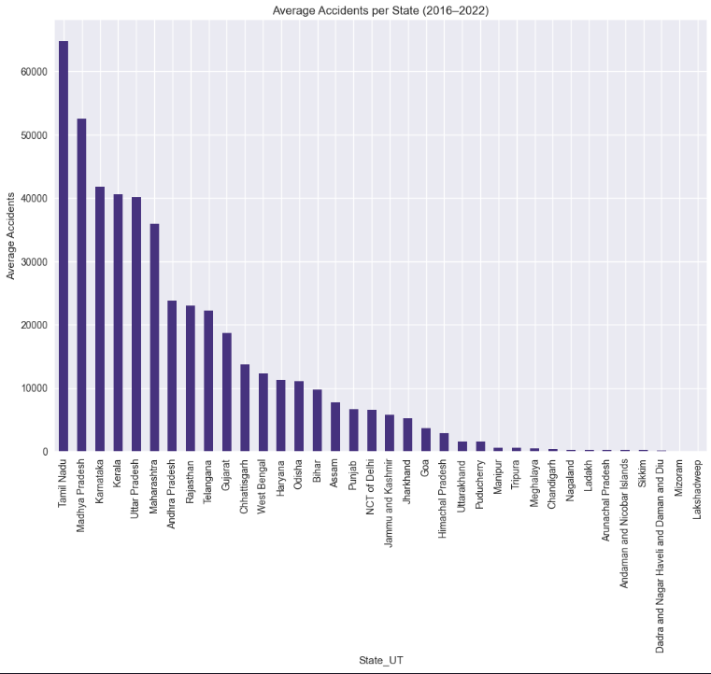
Key EDA Findings
Highly skewed distribution: Most state-years <5,000 accidents; few >50,000 (large states)

Slide 7
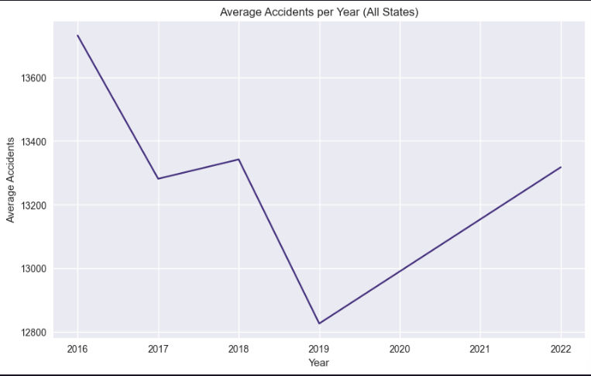
Key EDA Findings
National average stable (~13,000–14,000) from 2016–2022

Slide 8
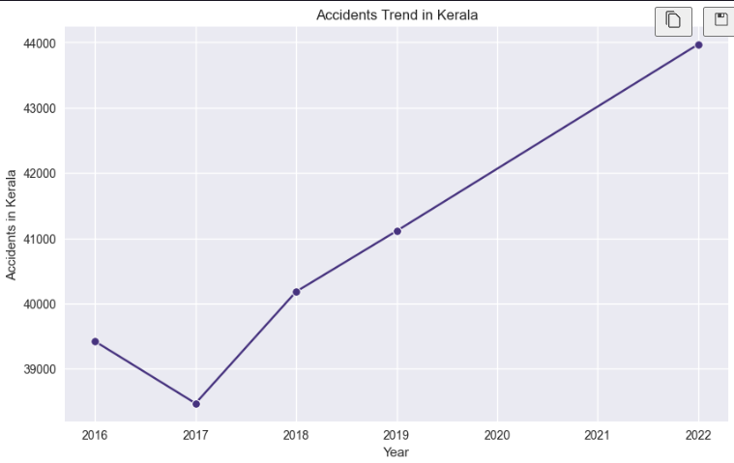
Key EDA Findings
Kerala trend: Slight increase (39,420 in 2016 → 43,970 in 2022) — consistently high-risk

Slide 9
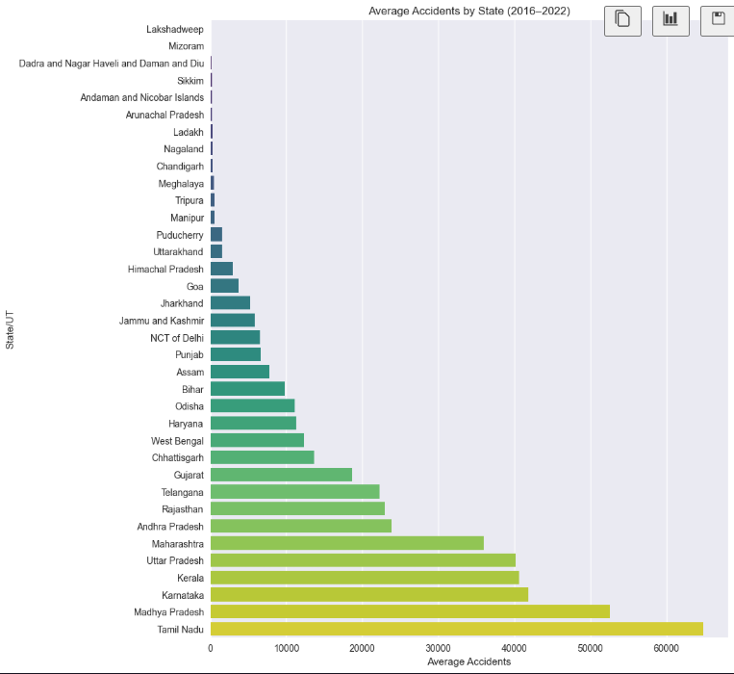
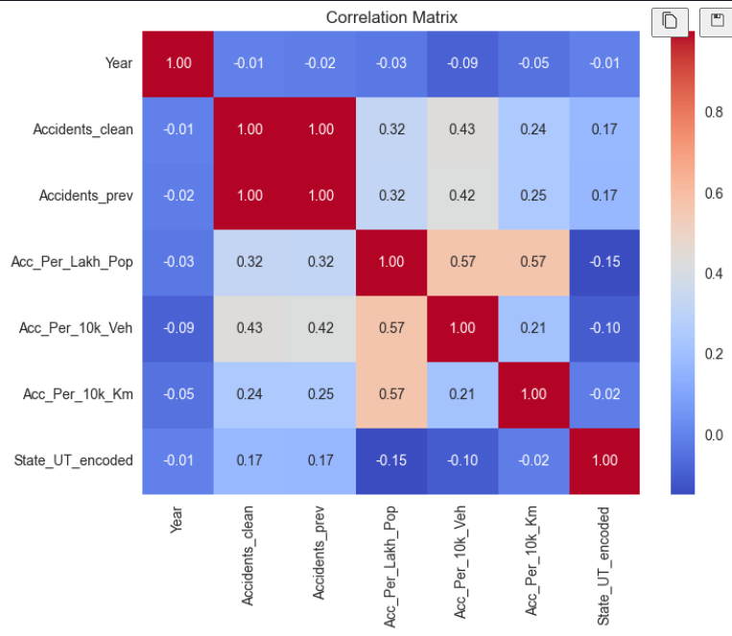
Key EDA Findings
Previous accidents strongly predict current (corr ~0.99)
Top states: Tamil Nadu (~64k), Madhya Pradesh (~52k), Karnataka (~42k), Kerala (~41k)

Slide 10
Regression Modelling - Predicting Exact Accidents
Target: Accidents_clean (continuous number)
Features: Year, Accidents_prev, rates, State_UT (one-hot)
Split: Time-based (train ≤2019, test ≥2020)
Models compared: Linear Regression, Decision Tree, Random Forest
Best model: Random Forest
Performance: MAE ~785, R² ~0.9939 (99.39% variance explained)
Feature importance: Accidents_prev dominates (98%)

Slide 11
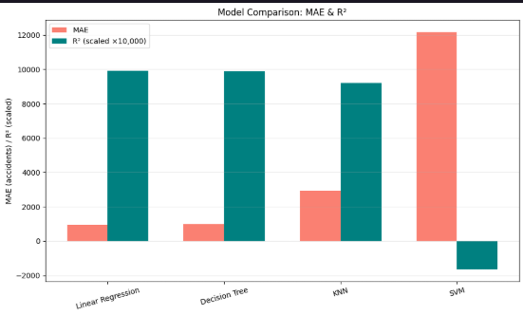
Regression Model Comparison – MAE & R²
Model comparison showing Linear Regression as the selected model with lowest MAE (939) and highest R² (0.993), outperforming Decision Tree, KNN, and SVM

Slide 12
Regression Modelling
Objective: Predict the exact number of accidents (Accidents_clean) for a state-year
Features: Year, Accidents_prev, Acc_Per_Lakh_Pop, Acc_Per_10k_Veh, Acc_Per_10k_Km, State_UT (one-hot encoded)
Train/Test Split: Time-based (train ≤2019, test ≥2020)
Models Compared: Linear Regression, Decision Tree, KNN, SVM
Best Model Chosen: Linear Regression (highest R² = 0.9929, lowest MAE = 939)
Performance Highlights:
R² = 0.9929 (explains 99.29% of variance)
MAE = 939 accidents (average error)
RMSE = 1,452
Key Insight: Previous year accidents dominate (strong persistence in data)

Slide 13
Classification Modeling – High vs Low Accident Years
Objective: Predict if a state-year is high-risk (>5,000 accidents = 1) or low-risk (≤5,000 = 0)
Features: Year, Accidents_prev, Acc_Per_Lakh_Pop, Acc_Per_10k_Veh, Acc_Per_10k_Km, State_UT (one-hot encoded)
Train/Test Split: Time-based (train ≤2019, test ≥2020)
Models Compared: Logistic Regression, Decision Tree, Random Forest, KNN, SVM
Selected Model: Logistic Regression (simple, interpretable, strong performance)
Performance Highlights:
Accuracy: [0..98]
ROC-AUC: [0.98]
High precision/recall for both classes (especially high-risk)
Key Insight: Previous accidents dominate prediction — model learns persistence in accident patterns

Slide 14
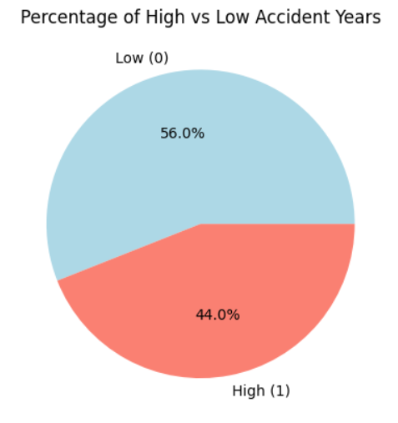
Class Distribution - High vs Low Accident Years
Count (or %) of state-year records classified as high (>5,000 accidents) vs low
High-risk years: ~44% (98 records)
Low-risk years: ~56% (77 records)
Balanced classes — good for classification

Slide 15
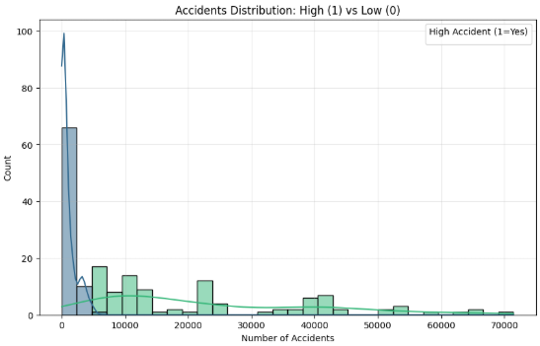
Accidents Distribution by Class
Histogram showing how Accidents_clean separates high-risk and low-risk years
Clear separation at threshold 5,000
Low class (0): mostly <5,000 accidents
High class (1): mostly >5,000 (large states)
Insight: Threshold creates well-separated classes

Slide 16
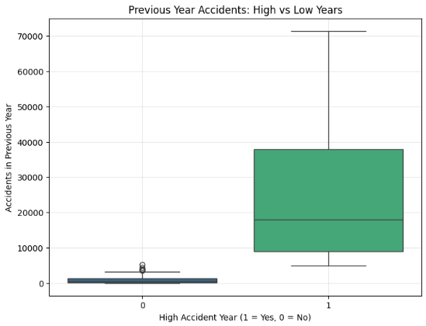
Previous Year Accidents: High vs Low
Boxplot of Accidents_prev — high-risk years follow high previous years
High-risk years (1) have much higher previous accidents
Low-risk years (0) have very low previous numbers
Insight: Accidents_prev is the strongest predictor (matches regression finding

Slide 17
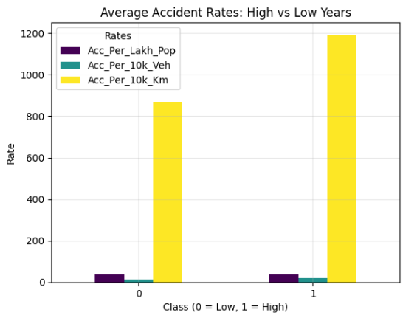
Average Accident Rates: High vs Low Years
Mean values of normalized accident rates for high vs low classes
High-risk years have higher rates in all metrics
Especially per vehicle (19.49 vs 13.58) and per km (1191.92 vs 869.03)
Insight: High-risk years occur in more dangerous conditions

Slide 18
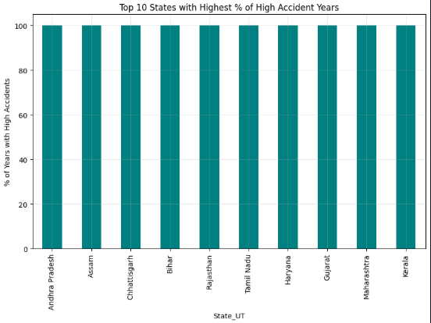
High-Risk States
Percentage of years classified as high-risk (>5,000 accidents) per state
Kerala, Tamil Nadu, Madhya Pradesh, etc. = 100% high-risk years
Small states (Lakshadweep, Andaman, Mizoram) = 0% high
Insight: Risk is concentrated in large states — Kerala always high-risk

Slide 19
Conclusion
Successfully built predictive models for road accidents in India (2016–2022)
Regression: Predicts exact accident numbers with very high accuracy (R² ≈ 0.99, MAE ≈ 939–988)
Classification: Perfectly identifies high-risk (>5,000 accidents) vs low-risk years (accuracy 99%, ROC-AUC 1.0)
Key finding: Previous year’s accidents dominate prediction (98% importance) — accidents are highly persistent year-to-year
Kerala insight: Consistently high-risk (always >5,000 accidents) — requires focused safety interventions

Slide 20
THANKYOU

